Slide 1

Promoting technologies for Grand Challenges and Crisis
Chapter 4
D. Foray
College of Management of Technology
October 2025
MGT 641

Slide 2

Framework – multiple areas of intervention, social experiment, coordination
Supply
Demand
Four areas of intervention
Economy
Technology & complementary infrastructures
Social practices (norms)
Through actions in these different areas – engaging agents into a process of transformation
(market) Tax
We need to pay for what we use
(governmt)
Regulation
‘Push’ – R&D subsidies
ARPA
‘Pull’ – AMC, PPI
What are the alternatives?
Nudges and awareness
Rationing?
Monitoring and measurement
Is the behavior observable?
Does it involve coordination benefits?
Industries
Atomicity bias?
TIP as an experiment
What works, what does not? What should be emphasized?
TIP as a big coordinated push
Optimal level of intervention How many instruments?
Redistributive effects – winners & losers
Narrative
Finance

Slide 3
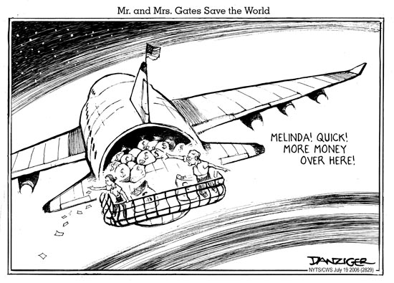
Multiple areas
Four areas of intervention
Technology
Technologies – essential part of transformation and solutions
Requires significant amount of resources as well as a relevant mechanisms to « allocate » the resources (push – pull)
Big question: is it possible to accelerate tech development?
But the production of knowledge is not deterministic
Through actions in these different areas – engaging agents into a process of transformation
‘Push’ – R&D subsidies
ARPA
‘Pull’ – AMC, prizes, PPI
How to spend the money?

Slide 4
Grant, prize, public procurement?
Push program
Pull program
How to accelerate technologies?

Slide 5
Some policy tools can target – not firms (tax, regulation) or consumers (social norms) – but the technologies which are needed to solve a ‘’problem’’
These tools can address costs – because innovation is expensive
  R&D subsidies – push logic
These tools can address expected revenues – because innovator’s rewards are poor on some markets
  Prizes, advanced market commitment – pull logic
These tools can address both cost and revenues through a public procurement logic
Some of these tools aim at « accelerating » development
  Advanced market commitment – pull logic

Slide 6

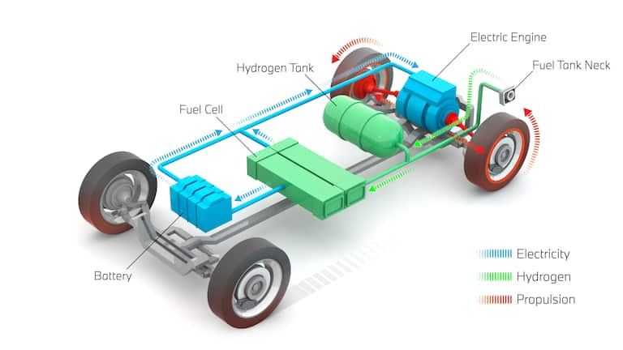
A Government is seeking for a specific innovation: hydrogen fuel tech (car); new drugs (obesity)
Push – to lower cost of innovation | Pull – to create rewards
R&D grants | Prize, AMC
A grant or a prize?
A grant is provided ex ante (based on a proposal which is selected)
A prize is given ex post (based on the achievement of the task)

Slide 7
A grant or a prize? The principal-agent problem
Principal pays (a funding state-agency, a philantropy) & agent executes (a firm, a research team)
Under a push logic, the principal pays in advance (for inputs: R&D costs) with no certainty whether a ‘useful’ output will be discovered/invented – this is the principle of research grants
  The whole risk is taken by the funder
  Research is characterized by strong information asymetry (the agent has more information about his/her actions than the principal then the agent may have an incentive to minimize effort) – it is difficult to monitor that the agent devotes full resources and efforts to this research.
Under a pull logic, the principal pays after the project, e.g. for the output (a product, a solution) – that mitigates greatly information asymetry problems but increases risk for participants
The distribution of risk is different whether this is pull (risk for innovator if she does not succeed) or push (risk for government who will pay even for failure)

Slide 8
Grant, prize, public procurement?
Push program
Pull program
How to accelerate technologies?

Slide 9
Push: Government research grants
Push: call for proposals in environmental engineering
With a R&D granting system based on a competitive process – call for proposals, evaluation, selection – it is possible to target some thematic areas where more R&D is needed
Variety of government programs to encourage innovation by providing grants to academic researchers or private firms
Principal-agent issue – the principal has difficulty to monitor and control the effort of the agent (above)
  Solution – instead of one single funding decision at the start, multiple check points opening the option to discontinue projects which are not working well – but difficult to do
Example Small Business Innovation and Research Act in the US
The Swiss mechanism
  Subsidies go to the university lab to support a partnership with a firm – no direct subsidies to companies
grants
outputs
High relevance
Some relevance
Irrelevant
Failures
Environmental engineering

Slide 10
Michael Kremer – why push programs raise issues – reading 3
The risk that grant funded scientists and research administrators competing for budgets will overestimate the chances of success and divert resources away from research are far from hypothetical
USAID « push program » to develop a malaria vaccine: focused on 3 teams
Team 1 – small clinical trial – mixed results, did not prevent USAID from issuing overoptimistic statements and continued support for a very long time woth no results
Team 2 produced disappointing results but the PI argued that his approach was still worth pursuing and requested an additional $2.3 million from USAID
Team 3 approach was evaluated as mediocre and unrealistic. But the project was fully funded
USAID had spend over $60 millions on malaria vaccine research with little progress
« The USAID case is extreme, and many push programs are quite successful. But the general principle remains that researchers funded under push programs have incentives to be overoptimistic, and since they are paid before delivering a product, they may be tempted to divert resources away from the main search supported by the grant »

Slide 11
Push program with high level of oversight and monitoring at execution phase - ARPA
Origin: DARPA
A typical ARPA process involves the following stages :
  The ARPA board is selecting a broad thematic area and hire a high standing potential program manager from academia, industry or elsewhere in government for a period of 3 to 5 years.
  The program manager has about one to 2 years to identify the specific target, design the program and build a network of partners, then she pitch the program to ARPA leadership and,
  If successful, launch several projects, monitor execution and make decisions about funding increase or cut within the remaining period.
  The total period of design, implementation and execution should not exceed 4 years

Slide 12
ARPA - Boundary conditions
it is possible to organize efficiently research & innovation around a technology related missions or a set of overarching goals;
it proved to be particularly optimal for technological areas where technology exists, is relatively unexplored and has great potential for improvement;
But…
A true ARPA schema implies for scientist to adjust her research agenda to fit the mission, a significant decrease of freedom to experiment and decentralized initiative.
Empowered staff and program managers of high standing and reputation is a boundary condition which might be difficult to fullfil in Europe.
  US culture of va et vient between the public and the private sector for high caliber scientists and managers is a strength here as well as some wage flexibility which can be used within the public administration to propose attractive package to high caliber managers or scientists (coming from private companies or top universities) for a 3 to 5 years temporary position in the public sector to manage an ARPA program.

Slide 13
Grant, prize, public procurement?
Push program
Pull program
How to accelerate technologies?

Slide 14
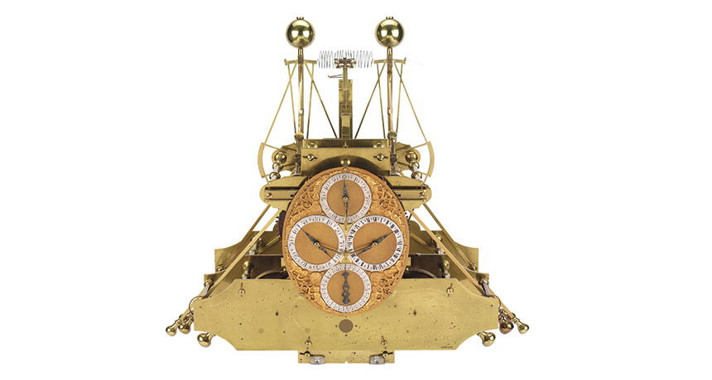
Pull: Grand prize for product development
Ex ante technical specification
Reward – access reconciled
Needs public funding (the reward is no longer based on monopoly rents)
In a push logic – probably only mathematicians and astronomers would have received subsidies – based on their track record
A pull logic opens the competition to any ‘’out of the box’ initiatives
In 1707, English navigators on a feet of five ships misjudged longitude and ran aground about 20 miles from the English shore. Many similar tragedies
To attempt to find a solution to this ‘longitude problem’, the British Government offered a prize of £20 000 for ‘a method of determining longitude within a half of a degree’
The Board of longitude monitored the competition and the solution was developed – not by astronomers or mathematicians – but by a clockmaker named John Harrison – it took 12 years to prove the worth of the chronometer and reward the inventor. J.H got his prize and gave his invention to the public domain

Slide 15

Grand prize for demonstration
In 1919, a New York hotel owner offered an aviation prize for the first person to fly across the Atlantic, nonstop Paris – New York. 25 year old Charles Lindbergh designed and supervised the construction of the ‘Spirit of St Louis’, complete with huge fuel tanks, longer wings, and a new location for the seat. He made his famous first solo flight across the Atlantic in 1927
Ex ante ‘technical’ specification to encourage demonstration projects (rather than spurring the development of a commercially viable product)

Slide 16
An important design feature: Metrics of ex post use or impact
Invention without diffusion of the invention is nothing!
One issue with prize is that products may be developed – they meet strictly the specifications - but for some reasons they are not desirable to consumers or clients (they don’t become innovations!)
Important to try to link reward to value
Useful to base reward payments on some measure of ex post valuation of the product by consumer
The reward will increase as a function not only of invention but diffusion
Diffusion may also be supported by « adoption subsidies »

Slide 17
A prize sponsored by a foundation (pull logic)
Can determine direction in a very detailed way – e.g. development of manufacturable,fast and affordable cars that exceeds 100MPGe (miles per gallon energy equivalent)
Mitigates principal-agent problems (it pays for the output)
  Money change hands only if successful products are developed – so sponsors need not worry to invest millions in a project that may ultimately fail (very different situation than in a push mechanism where the millions can be burned in unsuccessful projects)
  Minimize monitoring costs
Has a positive effect on diffusion: Prize is given for a public good – and possibility to link the amount of the prize with the magnitude of the diffusion
Create a large pool of contributors (spanning field/discipline boundaries) (unlike R&D grants whose selection process is partly based on reputation implying that some potential inventors censor themselves)
Need to find a good balance between too detailed ex ante specification (anti-competitive effect) and too vague/broad specification (no directionality)

Slide 18
XPRIZE Overview
What is XPRIZE? An XPRIZE is a highly leveraged, incentivized prize competition that pushes the limits of what’s possible to change the world for the better. It captures the world’s imagination and inspires
others to reach for similar goals, spurring innovation and accelerating the rate of positive change.
* The $2 Million Northrop Grumman Lunar Lander X CHALLENGE: Designed to build an industry of
American companies capable of routinely and safely flying vertical take-off and landing rocket
vehicles useful both for lunar exploration and for other applications.
o Created as part of NASA’s Centennial Challenges
o 12 teams spent > $20 million
o Earned contracts with government agencies and private customers
* The $1.4 Million Wendy Schmidt Oil Cleanup X CHALLENGE: To inspire a new generation of
innovative solutions that will speed the pace of cleaning up seawater surface oil resulting from
spillage from ocean platforms, tankers, and other sources.
o 38 teams from 4 nations
o Teams required to more than double the industry’s previous best oil recovery rate
o Winning team nearly quadrupled the industry’s previous best rate; and now has improved
to six times the rate
o Winning technology was rated No. 2 on National Geographic's "Most Hopeful Energy
Developments of 2011" and by the Washington Post as the No. 13 best moments in
innovations in 2011

Slide 19
A Government is seeking for a specific innovation: hydrogen fuel tech (car); new drugs (obesity)
Grant: Best fit to advance research and knowledge broadly
Prize: Best fit to support a specific product development and diffusion

Slide 20
Public procurement for innovation
Governments as lead customers use purchasing rules to promote innovation for specific societal goals
  Generates intitial momentum (learning effects, production costs, improvements in technology and process)
Example of US Green Building Council LEED Standard for sustainable building practices – (Leadership in Energy and Environmental Design)
Public agencies place orders for building meets LEED standard
The Governmt may be a major customer – then PPI can influence the behaviors of other stakeholders
Spillover effects – private sector LEED adoption is 80% greater in cities with a green building procurement policy (as well as in « neighbor cities »)
Mechanisms
  Increasing local awareness of the benefits of green practices (demonstration role)
  Jump-starting the development of a dynamic specialized input market (suppliers, architects) lowering prices of green-building expertise and materials
Governement PPI can break down important barriers to LEED adoption – addressing cost and revenue (push x pull)

Slide 21
Grant, prize, public procurement
Push program
Pull program
How to accelerate technologies?

Slide 22
Acceleration – extreme case
Can we make a business case for a drug to prevent or cure diseases concentrated in poor countries – in many cases there is simply no market?
Rich countries Governments or Charities could engineer a market where non yet exist – advanced market commitment (AMC)
  Evidence shows that markets work (to incentivize pharmaceutical companies)
Difference with the prize system – AMC creates a market
Under AMCs, donors make a legally binding commitment to buy at a high guaranteed price a vaccine if and when one is invented
If credible, such promise creates an incentive for for-profit companies to fund, test and make the targeted vaccine
The higher guaranteed price provides an economic return for innovators and developers, and in exchange the innovators agree to a cap in the long run price that they charge for the product.
  How to set the guaranteed price? – Should correspond to the value society would put on a vaccine
The product is bought at high guaranteed price BUT distributed at a low price during the AMCs
If no suitable product is developed, no AMC payments would be made

Slide 23
Country X ministry decides to buy the new vaccine – it will co-pay for $1 per dose and the company will receive a top up payment of $ 14 from the donor
Devil in details!!

Slide 24






24
Michael Kremer, an influential Harvard economist, first suggested the idea in 2000
An extensive consultation process was organized by an American think tank (2004-2005)
The report of the think tank was followed by work from the World Bank and the Italian government
G8 leaders agrees to launch a pilot AMC in July 2006 at the St Petersburg Summit
In February 2007 the pilot AMC (on pneumococcal vaccine) was launched http://www.vaccineamc.org/

Slide 25
From vaccines to climate
Apply an AMC scheme to deal with the problem of developing new carbon removal solutions: the global world will need to remove huge amounts of C02 from the atmosphere (5 to 10 billions of tons per year by 2050) and the world is not on track to do this.
Current solutions to capture carbon are not permanent and hard to manage and measure.
We need ‘’a gigaton-scale portfolio of permanent carbon removal solutions’’. These technologies don’t yet exist and will be very expensive to develop and scale up.
The financial solution may be to involve companies and governments with net-zero pledges which will fund the AMC by formalizing their financial commitment to buy carbon removal over a certain time period. When tons of CO2 get removed, the AMC will pay suppliers of new technologies and issue credits back to buyers.
Such an approach will send strong market signal – stronger than fragmented companies making net-zero commitments while potential innovators are facing great uncertainties about what kind of solutions will be selected by the market.
Another great advantage is that this market signal can be sent NOW – in spite of the fact the technologies are not yet ready.

Slide 26
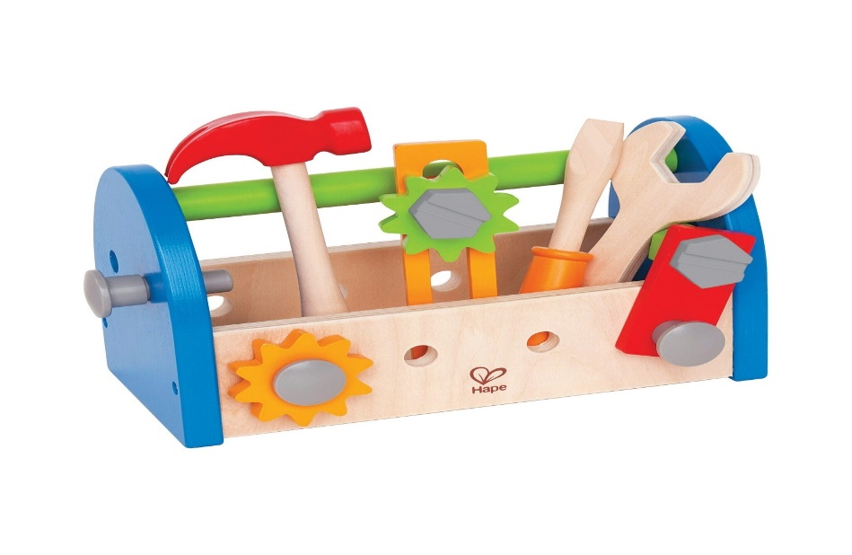
Wrapping up – the toolbox to develop specific technologies
 | Science advancement | Product development , demonstration & adoption | Diffusion
Push instruments: address costs | Grants & subsidies | Subsidies through ARPA | Adoption subsidies
Pull instruments: address revenue | Prize (in math) | Prize Advanced market commitment | Metric of ex post use Patent buy out
Push x pull – address cost and revenue |  | Public procurement | Spillovers to private markets
Recommended reading – Kremer and Williams
Kremer

Slide 27
Wrapping up – the toolbox to develop specific technologies
Vaccine development
Hybrid heating system
New antibiotics
Substitute to pesticides
AI applications
Solutions to eradicate mosquitoes
Technologies for sorting and recycling garbages
….
 | Science advancement | Product development , demonstration & adoption | Diffusion and adoption of the new solution
Push instruments: address costs | Grants & subsidies | Subsidies through ARPA | Adoption subsidies
Pull instruments: address revenue | Prize (in math) | Prize Advanced market commitment | Metric of ex post use
Push x pull – address cost and revenue |  | Public procurement | Spillovers to private markets
Recommended reading – Kremer and Williams
Kremer

Slide 28

Merci

